Slide 1


Strategic Plan
2007-2010

Slide 2

Strategy One
Provide needs-based, relevant, quality programs, training, and services to individuals and businesses that compete in a global economy.

Slide 3

Strategy One
Facilitators: Sheree Utash & Scott Lucas
  This strategy targets:
    Highlighting instructor best practices
    Assessment of instructional effectiveness (faculty, curriculum – including global professional standards & academic success courses)
    Assessment of student learning
    Relationships and their effectiveness with business & industry partners
    Increasing program offerings and deployment options
    Seamlessness of educational career paths
    Validation of curriculum

Slide 4

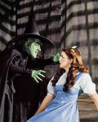

Strategy Two
Develop relationships with internal and external constituents to convey the value, relevancy, and quality of WATC.

Slide 5
Strategy Two
Facilitator: Shirley Antes
  This strategy targets:
    Student & employee satisfaction
    Effectiveness of marketing plan
    Relationships & image as perceived by business partners and other relevant constituents
    Implementation of accreditation recommendations

Slide 6
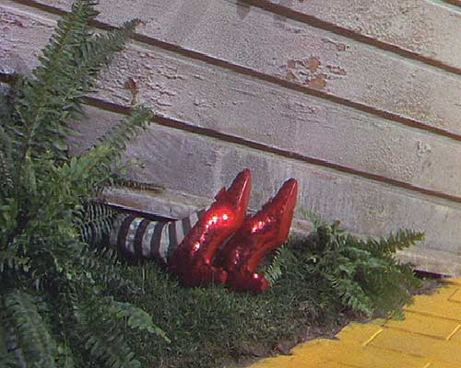
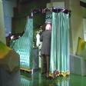
Strategy Three
Provide cutting-edge technologies and facilities that reflect and support quality technical education.

Slide 7
Strategy Three
Facilitators: Diane Wright & Randy Roebuck
  This strategy targets:
    Funds for technology
    Satisfaction with technology in the work place and implementation of improvements
    Deployment of a technology plan
    Satisfaction with facility related issues and implementation of improvements

Slide 8



Strategy Four
Assure financial viability and growth.

Slide 9
Strategy Four
Facilitators: Ginnie Cary & Steve Field
  This strategy targets:
    Analysis of funding initiatives
    Increasing grants & foundation funding
    State & local advocacy for increased funding

Slide 10

Strategy Five
Facilitate academic success through excellent and comprehensive support services.

Slide 11
Strategy Five
Facilitators: Pam Doyle & Jessica Ross
  This strategy targets:
    Increasing enrollment
    Student satisfaction with learner services
    Increasing retention
    Increasing placement rates

Slide 12

Strategy Six
Develop human capital in an environment where excellence is valued and rewarded.

Slide 13
Strategy Six
Facilitators: Shawne Boyd & Amy Buhrman
  This strategy targets:
    Improving employee satisfaction in the work environment
    Redefining and implementing human resource policies
    Development & deployment of employee evaluation tools
    Development & deployment of an employee reward & recognition system
    Development & deployment of a comprehensive workforce plan
    Deployment & satisfaction with employee professional development activities
    Implementation of diversity training

Slide 14

And Back to Kansas they Went!!!

Slide 15
Planning for Success
2011-2016

Slide 16
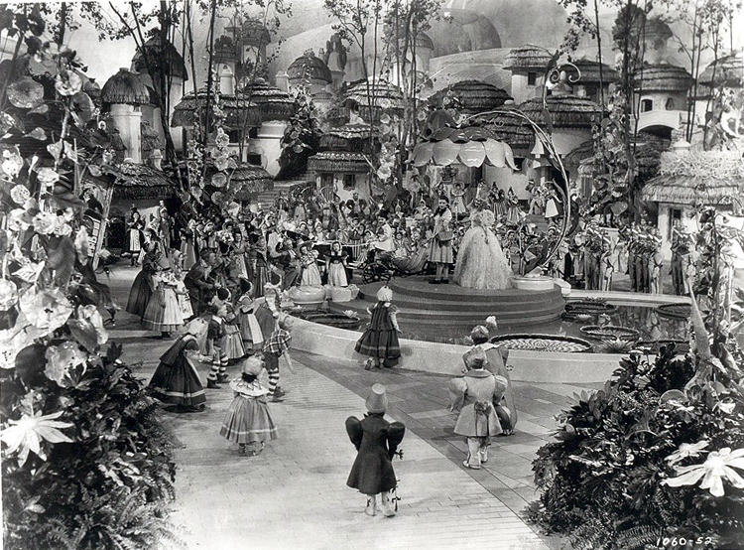


Slide 17
They each had a MISSION.

Slide 18
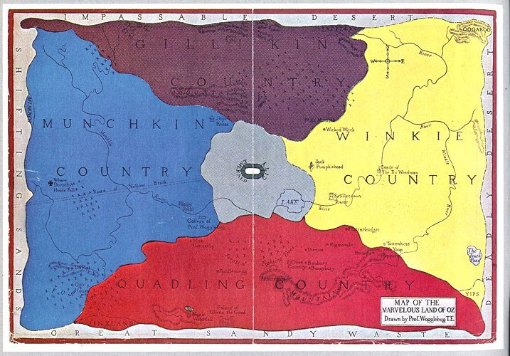
Is our Mission - still our Mission?

Slide 19
Current Mission Statement
The mission of Wichita Area Technical College is to provide relevant, technical education and training that meets the needs of learners, the community, and industry while instilling a positive work ethic and desire for lifelong learning.

Slide 20
Mission Statement Board Options
Wichita Area Technical College provides the highest quality programs that meets the needs of learners, business and industry partners, and the community while instilling a quality of professionalism and continuous learning.
OR
Wichita Area Technical College provides a comprehensive higher education for employment and continuous learning to promote individual growth and economic development.

Slide 21
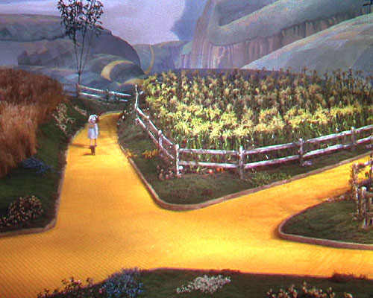
“If you don’t know where you’re going,
any road will take you there.”
Lewis Carroll

Slide 22
Current Vision Statement
Wichita Area Technical College will be recognized as the premier technical college in the Midwest with highly qualified faculty, state-of-the-art facilities, programs, and technologically advanced resources.

Slide 23
Vision Statement Board Modifications
Wichita Area Technical College will be the leading provider of technical education, providing a competitive advantage that drives economic development in the region.

Slide 24

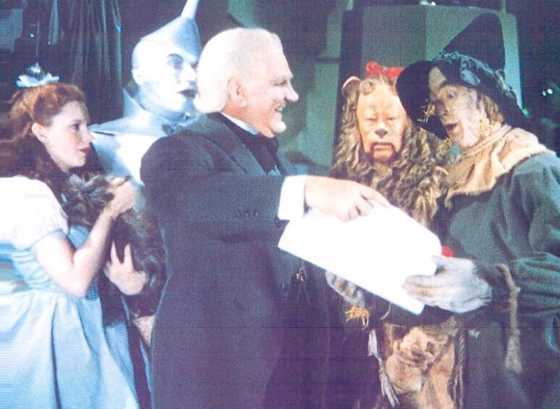

Even the Characters in the
Wizard of Oz had Values

Slide 25
Value Statements & Options
Accountability: WATC values the resources entrusted to it and will use them responsibly to support the college’s mission.
Quality: WATC values the desire of students, faculty, and staff to learn and work in an environment that encourages professionalism and excellence.
Education for Employment: WATC values the importance of technical and general education in preparing students for high-skill, high-demand, and high-wage jobs that meet workforce and economic development needs.
Innovation: WATC values a state-of-the-art learning environment, including alternative delivery methods and flexible scheduling, that encourages all members of the community to participate fully in lifelong learning within a rapidly changing society.
Customer Service: WATC values the diverse needs of its customers as it seeks to exceed their expectations and in responding to the desires of its various community and educational partners.
Collaboration: WATC values its responsiveness to meet the needs and specific requirements of its partnerships with community and business groups, educational systems, and governmental agencies.
Equity/Diversity: WATC values the diverse nature of its students, faculty, and staff and seeks to treat each person with the utmost respect.
Work Ethics Global Professional Standards: WATC values behaviors that promote responsible, successful, and ethical students, employees, and citizens.

Slide 26
To get us where WE want to go we must create our map for getting there by identifying our
Strategies
& Goals

Slide 27
Considerations for
2011-2016 Strategic Plan

Slide 28

What Courageous Things Shall We Pursue Over The Next Five Years?

Slide 29
Target Areas?
Measurements of
Success?

Slide 30


